Slide 1
News Analytics
Team Members:
Leandra Menezes, Neha Ghate

Slide 2
Are you ready to read RELEVANT NEWS ? Here is how News Analytics can help you

Slide 3
Goals of the project
News analytics refers to making analysis of the daily news to categorize into some insightful data. Being
able to express news stories as numbers permits the manipulation of everyday information in a statistical
way that allows computers not only to make decisions once made only by humans, but to do so more
efficiently. We intend to use Spark, clustering algorithms to reach the result. This project aims to:
Develop UI for news portal
Track and analyze news with interactive real time visualizations.
Filter and display news analytics based on different criteria.
Spot hidden patterns and trends in masses of news information.

Slide 4
Key Milestones in the project
Step 1: Research on finding out news patterns
Step 2: Develop WebCrawler
Step 3: Filtering data generated
Step 4: Separating data into words, text and URL
Step 5: Saving in a text file with filtered – relevant, distinct, stopwords removed
Step 6: Displaying news to the user allowing him to select his interested news
Step 7: Finding out the word generated from the interested news and showing the user news urls with the word contained in it
Step 8: Developing Test Cases

Slide 5
What tools were used?
IDE : IntelliJ
Tools : Spark

Slide 6
Research on finding news patterns
Based on the research done by us most of the urls are of the following forms:
http://www.vox.com/2016/4/19/11458024/snyder-michigan-flint-water
OR http://www.slate.com/articles/health_and_science/future_tense/2016/04/biomedicine_facing_a_worse_replication_crisis_than_the_one_plaguing_psychology.html
As you can see the URL contains 2016 which indicates they are the news articles
Also the articles is separated by (_ or - )
Hence filtering is to be done based on the above two points

Slide 7
How did we generate data?
Used Web crawler to collect URLS from various News portals
Some of the news portals used:
http://www.nytimes.com/
https://www.washingtonpost.com/
http://www.foxnews.com/
http://www.vox.com/

Slide 8
How was data filtered?
Filter out URL which contain 2016
Split the URL based on word, text and URL where
for eg: Consider the following URL http://www.slate.com/articles/health_and_science/future_tense/2016/04/biomedicine_facing_a_worse_replication_crisis_than_the_one_plaguing_psychology.html
Word: Biomedicine, facing, worse, replication, plaguing, psychology
Text: biomedicine_facing_a_worse_replication_crisis_than_the_one_plaguing_psychology
URL: http://www.slate.com/articles/health_and_science/future_tense/2016/04/biomedicine_facing_a_worse_replication_crisis_than_the_one_plaguing_psychology.html

Slide 9
Amount of data generated
Web Crawler generated : 4386 Lines
Filtered Data with news articles: 1654 Lines

Slide 10
Programming in scala
(Well, everything !)
Web Crawler
Filtering Data
Storing in text file and retrieving

Slide 11
Scala Tests
Total No of Scala Tests written: 11
Scala tests written on: Webcrawler, FilterNewsURL and LinkCleaner

Slide 12
Working of the project
cleanedNewsURLs (filtered with 2016, distinct, stop words)
Web Crawler
newsURLs ( Crawled news URLs)
Display relevant news
Get interested URL from user
Display some news to the user

Slide 13
Acceptance Criteria
Generated 4386 lines of URLS.
Users will be shown news recommendation on his likes and dislikes ( achieved a prediction rate of 0.60.)
Completed 80 % of major milestones.

Slide 14
Sprint tasks result
Tasks completed:
Web crawler news URL
Filtering Data
Showing relevant URLS to the user
Tasks yet to be completed
Developing UI
Multiuser application
Generating reports

Slide 15
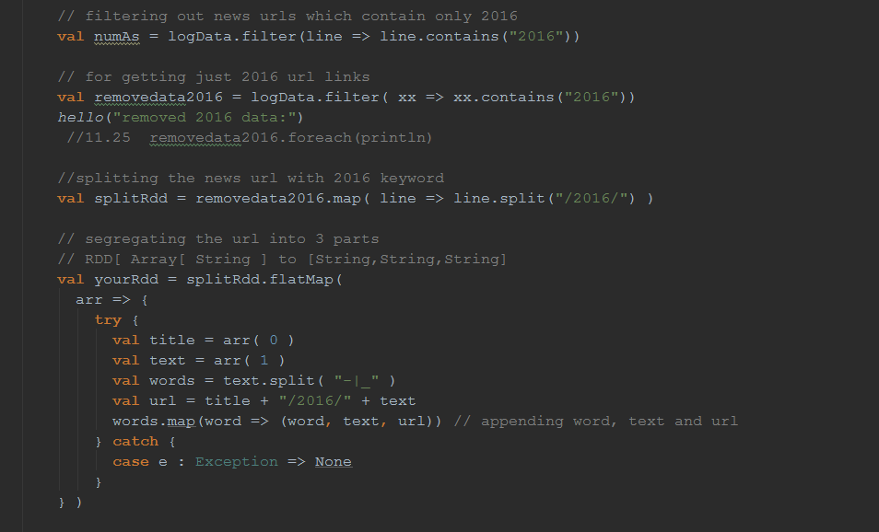
Code snippet for data filtering
Data was filtered using ‘Filter’ to collect only 2016 URL’S.
The URL was then split into word, text and url
‘yourdd’ contains a map of word, text and url

Slide 16
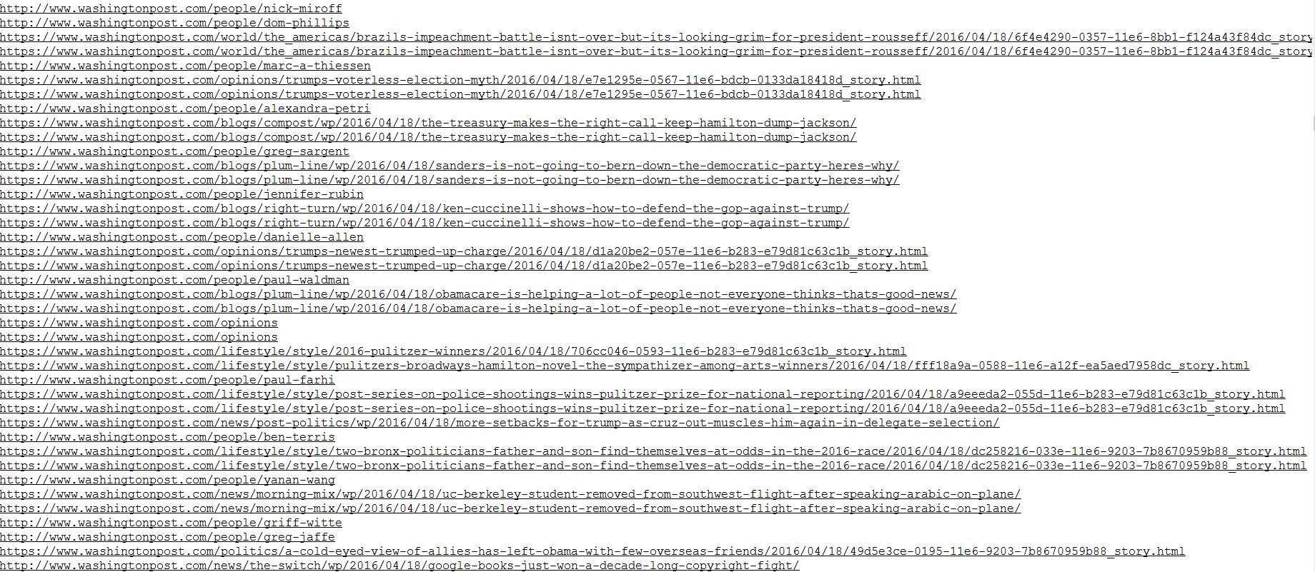
Web crawled urls
Contains a list of all the URL’S crawled using WebCrawler

Slide 17
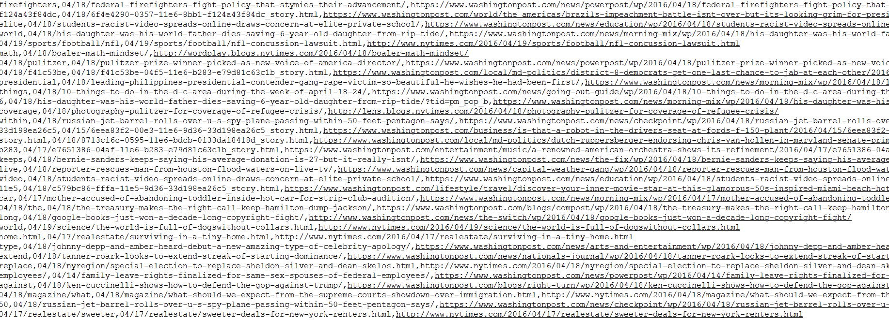
Cleaned meaningful data
Contains a cleaned url – 2016, split by word text and URL

Slide 18
Use case
Case 1: User is shown list of news article URLs
Case 2: User inputs the news article URL of his interest
Case 3: Application shows the list of news articles based on his interests

Slide 19
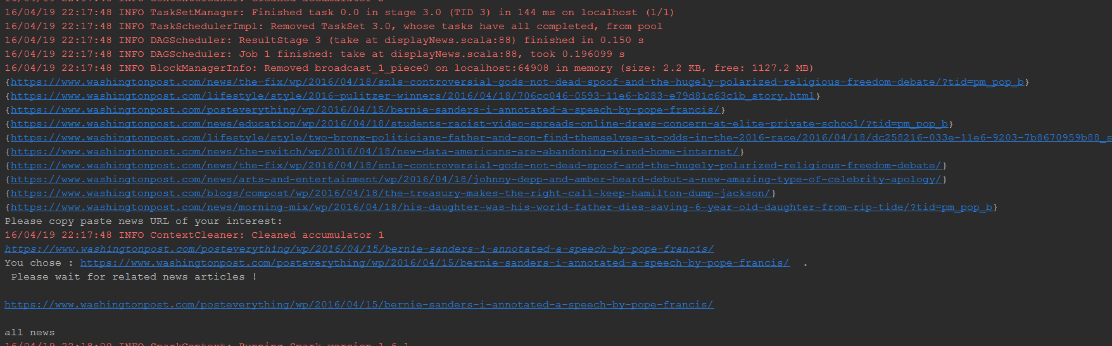
User selects URL

Slide 20
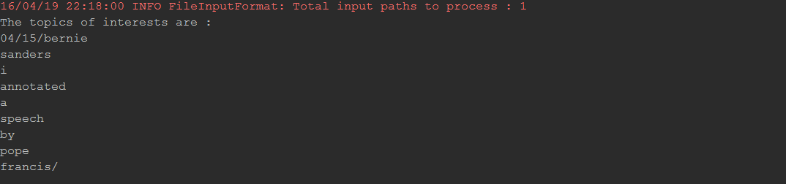
Words Generated from User’s Interested news

Slide 21
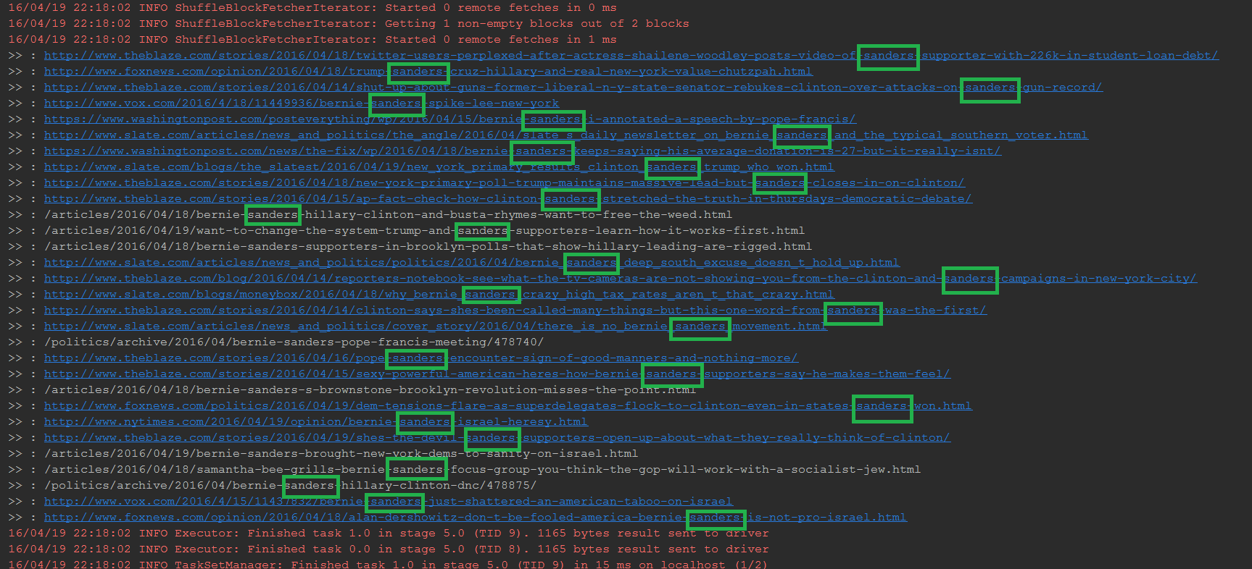
Suggested News
News suggested based on the word: Sanders

Slide 22
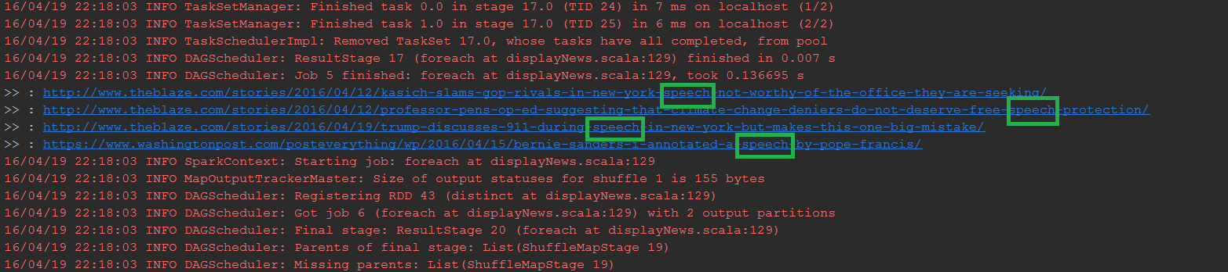
Suggested News
News suggested based on the word: Speech

Slide 23
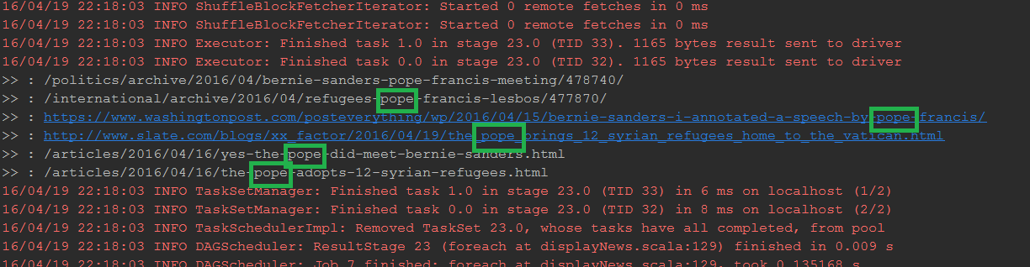
Suggested News
News suggested based on the word: Pope

Slide 24
Thank You!

